Slide 1



PROJECT REPORT
Data Wrangling & Analysis
for Ophthalmology Drug Tracking
Integrating invoice, inventory, and claims data to uncover operational inefficiencies and maximize revenue recovery.
Scope Injectable Inventory
Presented By:
Arbia Garfa

Slide 2
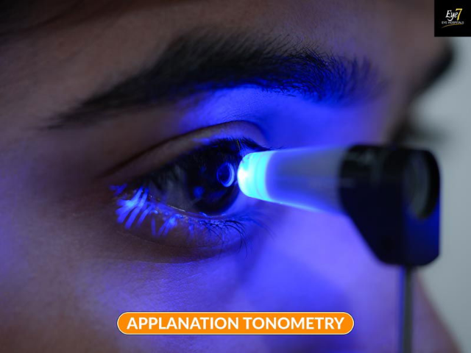
Introduction
The High Cost of Care
Ophthalmology practices manage high-cost injectable drugs (e.g., Eylea, Lucentis) that require precise inventory control.
Any discrepancy between procurement and reimbursement results in significant direct revenue leakage.
Project Goal:
This project integrates invoices, dispense logs, and claims into a unified framework to identify inefficiencies and prevent financial loss.

Slide 3











Project Objectives
Data Integration
Data Cleaning
Operational Analysis
Merge supplier, inventory, and billing datasets into a single source of truth.
Address duplicates, symbols in numeric fields, and missing values (42k+ gaps).
Detect unscanned dispensed vials and quantify the exact revenue impact.
Financial Analysis
Statistical Insights
Predictive Modeling
Calculate precise Revenue, COGS, and Profit margins per vial.
Test hypotheses regarding reimbursement differences in denied vs. approved claims.
Prepare clean datasets for ML models to predict future claim denials.

Slide 4


Methodology: Data Wrangling
Normalization: Stripped symbols (e.g., "$") from numeric fields like Purchase Price to ensure calculation accuracy.
Integration Strategy: Merged datasets using key composite identifiers:
Invoice Number
Vial Number
Dispense ID
Missing Data Strategy: Addressed 42,786 missing values using forward-fill logic, reducing residual gaps to just 9.
Quality Check: Verified 0 duplicates post-processing.

Slide 5

Exploratory Data Analysis
Key Distributions
Histograms revealed that both Purchase Prices and Claim Reimbursements are positively skewed.
Purchase Price Distribution (Skewed)
Correlation Findings:
Weak correlation observed between purchase price and reimbursement amount.
Minimal multicollinearity among numeric features, suggesting robust independent variables for modeling.

Slide 6

Statistical Verification
Hypothesis: "Do approved and denied claims differ significantly in reimbursement amount?"
p = 0.9831
Result: Fail to Reject H₀
Interpretation: There is no statistically significant difference in the billed amounts between denied and approved claims. Denials are likely due to process errors, not cost thresholds.

Slide 7



Financial Performance
$1.98M
$759.6K
$1.22M
TOTAL REVENUE
COST OF GOODS SOLD
NET PROFIT
(Reimbursed Claims)
(Inventory Cost)
(~62% Overall Margin)
Despite operational leakage, the fundamental profitability of the inventory remains strong.

Slide 8

Profitability Deep Dive
High-Margin Inventory
Analysis of individual vial performance indicates exceptionally high margins for specific inventory lots, reaching up to ~75%.
Profit Margin Distribution
Top Performing Vials (Sample):
Vial ID | Cost | Reimbursed | Margin
VN-0000010 | $50.00 | $199.98 | 74.99%
VN-0000011 | $50.00 | $199.98 | 74.99%
VN-0000012 | $50.00 | $199.98 | 74.99%
0% 20% 40% 60% 80%
Most vials cluster around 60-70% margin.

Slide 9


Operational Gap: Unscanned Vials
875
Vials Dispensed but NOT Scanned
Impact Analysis
Revenue Leakage: These vials cannot be billed to insurance without proper dispense logs.
Compliance Risk: Lack of traceability for administered drugs.
Inventory Drift: Physical inventory does not match digital records, leading to ordering errors.

Slide 10



Claims Analysis: Denials
Denial Inefficiencies
While the denial rate is relatively low (~3.5%), 561 denied claims represent missed revenue opportunities.
561 Denied Claims
Root Causes
Denials are statistically independent of the claim amount (as proven by the T-test). This implies administrative errors:
•
Incorrect coding
•
Eligibility verification failures
•
Missing documentation

Slide 11

Predictive Modeling
To move from reactive analysis to proactive prevention, we prepared datasets for Machine Learning.
Strategy
Target Variable: Claim Denial (Binary: 0/1).
Feature Engineering: Created 9 engineered features using One-Hot Encoding to capture categorical nuances.
Split: 80/20 Train-Test split, stratified to maintain the ~3.5% denial proportion in both sets.
Goal: Train Random Forest/XGBoost models to flag high-risk claims before submission.

Slide 12
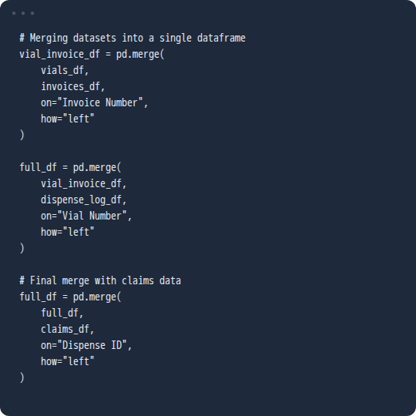
Implementation: Data Merging
Python Implementation
The core of the analysis relied on merging disparated datasets (invoices, logs, claims) to create a single "Full View" dataframe.
This code snippet demonstrates the Left Join strategy used to preserve all inventory records even if they lack a downstream claim.

Slide 13


Recommendation: Inventory Control
Stop the Leakage
To address the 875 unscanned vials, we recommend:
Mandatory Scanning: Enforce barcode scanning at the point of dispensation. No scan = No dispense.
Real-Time Tracking: Link every scan directly to a Patient ID and the dispensing staff member's username.
Daily Reconciliation: Automated report comparing "Vials Removed" vs. "Scans Logged" to catch discrepancies within 24 hours.

Slide 14





Recommendation: Financial Controls
Pre-Claim Validation
Standardized Data Entry
New KPIs
Implement automated eligibility checks and document validation layers to reduce the 561 denied claims.
Establish strict data governance to prevent the massive missing values (42k) seen in the raw data.
Track "Unscanned Vial Rate" and "Reimbursement Turnaround Time" as primary operational metrics.

Slide 15

Future Roadmap
Phase 1: ETL
Phase 2: AI Model
Phase 3: Forecasting
Automate pipelines for clean data integration.
Deploy denial prediction model.
Predict drug demand to optimize ordering.

Slide 16
Q & A
Thank you for your attention.
Data Analysis Team | Ophthalmology Ops

Slide 17
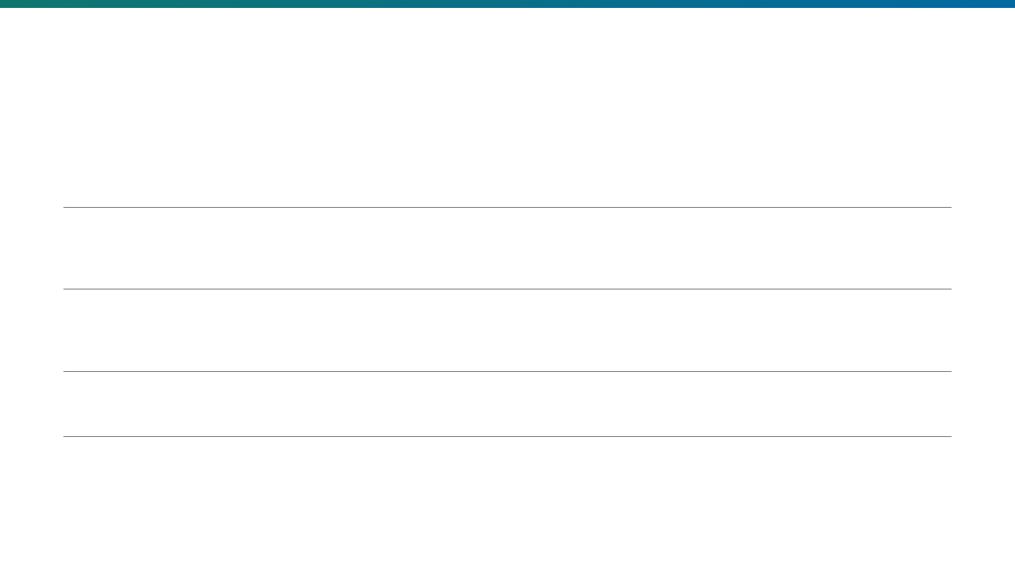





Image Sources
https://eye7.b-cdn.net/wp-content/uploads/applanation-tonometry.jpg
Source: www.eye7.in
https://img.freepik.com/premium-vector/data-analyst-working-with-multiple-screens-showing-graphs-world-maps-office-environment-vector-illustration_126712-47463.jpg?w=360
Source: www.freepik.com
https://static.vecteezy.com/system/resources/previews/031/696/916/large_2x/medical-vials-moving-along-a-production-line-in-a-pharmaceutical-factory-ai-generated-photo.jpg
Source: www.vecteezy.com
https://img.freepik.com/premium-photo/flat-abstract-ai-brain-with-digital-nodes-isolated-white-background-concept-as-stylized-abst_980716-599794.jpg
Source: www.freepik.com
https://media.istockphoto.com/id/1135420243/photo/pharmacist-scanning-medicine-bottle-with-barcode-scanner-in-chemist-shop.jpg?s=612x612&w=is&k=20&c=FzhfpgrIZ6f8IxsG7FMzbeCmIPXAJMRkp2IOymXpDnw=
Source: www.istockphoto.com

